Slide 1







THE IMPORTANCE OF ANIMAL RESCUE IN BANGLADESH
“Rescue”, it’s not just a verb, it’s a promise.

Slide 2


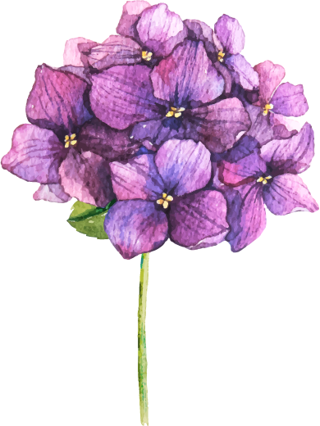
Name: Syeda Shabnam Mahmud Department: Department of English Course: ENG 102 Section: 05
Submitted To

Slide 3
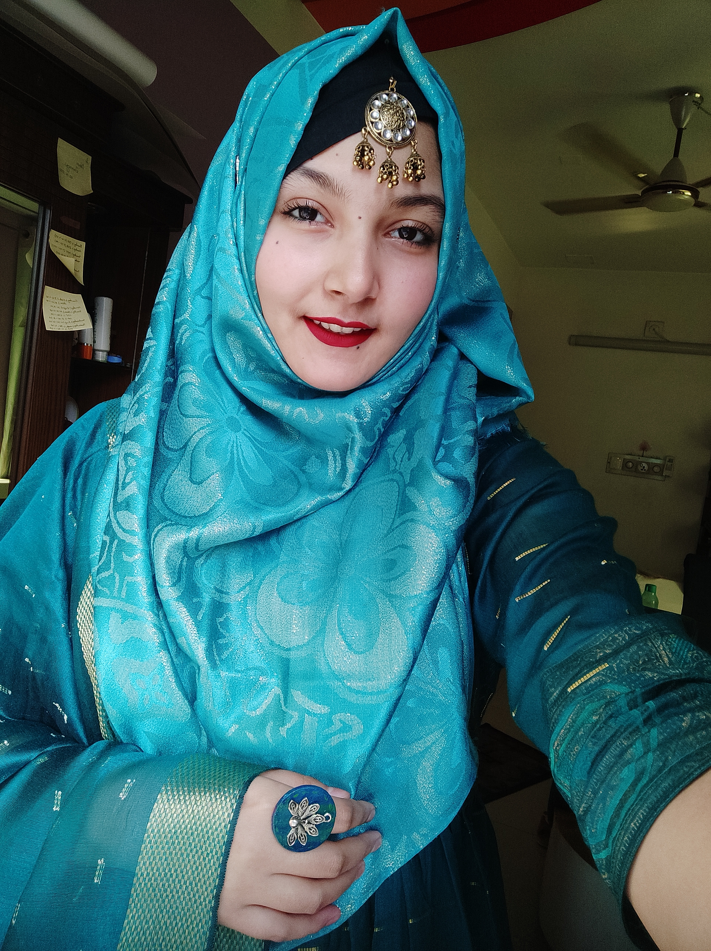

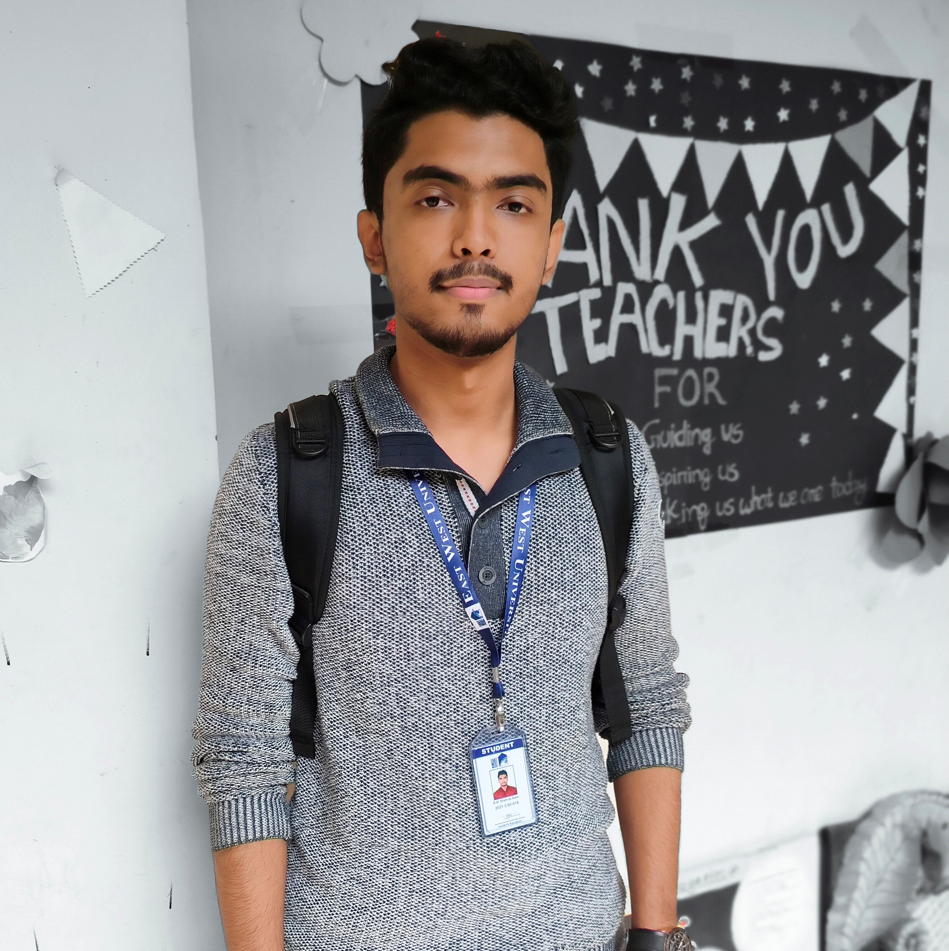


Submitted By
Name: Nayma Amin Nishy
Department: Computer Science and Engineering
ID: 2021-3-60-178
Name: Sidratul Moontaha
Department: Computer Science and Engineering
ID: 2021-3-60-048
Name: B M Shahria Alam
Department: Computer Science and Engineering
ID: 2021-3-60-016
Name: Arman Sheikh
Department: Computer Science and Engineering
ID: 2021-3-60-015

Slide 4
Introduction
The importance of animal rescue in Bangladesh.
“When it comes to saving a life, nothing else should matter.” In this term paper project we talk about every single detail that explains why it is important to save animals.

Slide 5
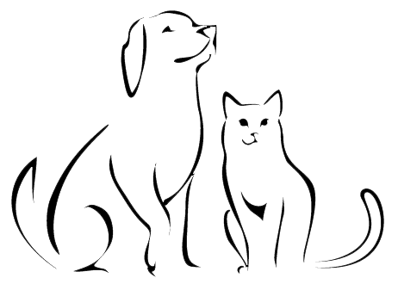
WHY DID WE CHOOSE THIS TOPIC?
`
Animals also need love and care just like children. There are a lot of stray animals who face many difficulties in the street. Just like human beings they deserve a beautiful life. Every rescuer works to give these animals a good life. We want to show the good works of the rescuers along with the thought of making everyone aware of the importance of Animal Rescue.

Slide 6


Introduction
Here’s what you’ll find in this Slidesgo template:
A slide structure based on a Thesis presentation, which you can easily adapt to your needs. For more info on how to edit the template, please visit Slidesgo School or read our FAQs.
An assortment of graphic resources that are suitable for use in the presentation can be found in the alternative resources slide.
A thanks slide, which you must keep so that proper credits for our design are given.
A resources slide, where you’ll find links to all the elements used in the template.
Instructions for use.
Final slides with:
The fonts and colors used in the template.
A selection of illustrations. You can also customize and animate them as you wish with the online editor. Visit Storyset to find more.
More infographic resources, whose size and color can be edited.
Sets of customizable icons of the following themes: general, business, avatar, creative process, education, help & support, medical, nature, performing arts, SEO & marketing, and teamwork.
You can delete this slide when you’re done editing the presentation
RESEARCH QUESTIONS
Question 1 :
How do they get the information and rescue those animals in need?
Question 2 :
Where do they treat the wounded animals and give them shelter?

Slide 7







Three articles that are relevant to our topic
Animal Rescue: The Best Job There Is
01
In this article the writer Susan E. Goodman shared three Animal Rescue stories about Jungle Rescue, Wartime Rescue and Earthquake Rescue.
Whenever there's a natural disaster everyone helps the humans but who helps the animals?
This article shows how important it is to save every life.
Resource: https://books.google.com.bd/books?hl=en&lr=&id=yXFYBQAAQBAJ&oi=fnd&pg=PA5&dq=related:8aICmko7K20J:scholar.google.com/&ots=v85UEAiycB&sig=X5x23C06cJanOq8Py_GZspuSghg&redir_esc=y#v=onepage&q&f=false

Slide 8



02
Veterinary treatment and rehabilitation of indigenous wildlife.
In this article the writer E. Mullineaux talks about how to give treatment to a rescued animal and about their rehabilitation. The writer also shows treatment details and future results.
Resource: https://onlinelibrary.wiley.com/doi/10.1111/jsap.12213

Slide 9
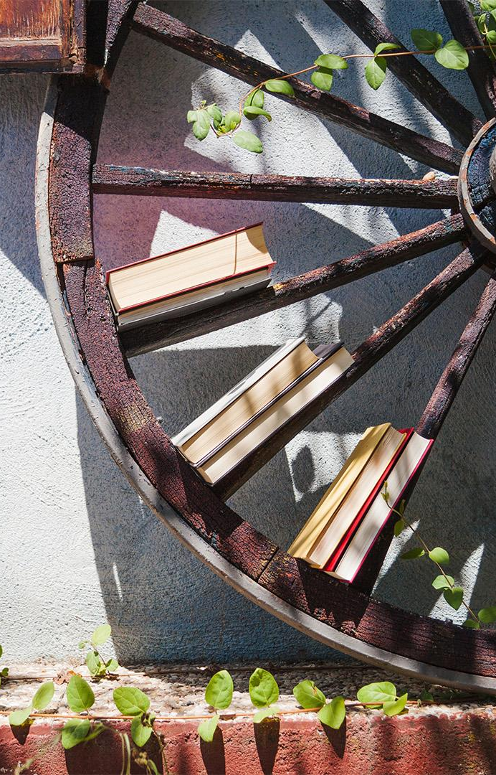
03
Animal shelters and animal welfare: Raising the bar
In this article the writer's Patricia Turner, Jim Berry and Shelagh MacDonald talk about the importance of Animal shelter. They provide us with a chart that shows the improvement of animal welfare and shelters throughout the years.
Resource: https://www.ncbi.nlm.nih.gov/pmc/articles/PMC3398531/

Slide 10
Method:
Method 1
Method 2
Qualitative where we have our interview questions.
Quantitative where we have our survey question.

Slide 11
Interview questions:
Where did they find the Idea of rescuing ?
How do they get information?
How do they rescue?
If they have their own veterinary clinic and about the clinic if they have one?
If they don’t have a veterinary clinic then how do they provide treatment?
Where do they give the animals shelter?
Do they help them to get adopted?
Do they stay connected with them even after adoption?

Slide 12
Interview answers:
How do you get the information and rescue the animals? Ans: We mainly get information from our helpline number which is 999. We get information from social media like Facebook, Instagram, WhatsApp etc. About rescue, we have our vehicles that we use to reach the place faster. We always carry ropes, ladders, first aid kits etc. First we try to understand the situation and after that we take steps to rescue the animals.
Where do you treat those animals ? Ans: We have our own veterinary clinic. We have our personal animal doctors, treatment equipment and medicines. So, after rescuing we give them treatments depending on their need as soon as possible.
Name: Robin Sheikh
Age: 28 years
Occupation: Rescuer
“Professional rescuer at RobinHood”

Slide 13
Interview answers:
3. Where do you keep them after treatment?
Ans: We give them up for adoption, sometimes we return them to nature and sometimes they stay in our rescue centre. So, it depends on the situation.
4. Tell us about Robinhood The Animal Rescuer in short ?
Ans: Everything started with the love for animals. The owner of Robinhood was always an animal lover. He always wanted to do something for these pure souls. This organization was started by our owner and his sister. After that eventually it started growing. The journey started with a vow, “When it comes to saving a life, nothing else matters.”
Name: Robin Sheikh
Age: 28 years
Occupation: Rescuer
“Professional rescuer at RobinHood”

Slide 14
Interview answers:
How do you get the information and rescue the animals? Ans: We kind of have a small team of rescuers who try to rescue these animals and work together. We mostly get this information from social media groups. Where people post and seek help. We also get phone calls. We rescue them considering their mental and physical health. First we try to interact with them , win their trust and just take them away from the problems.
Where do you treat those animals ? Ans: We have our own veterinary team but sometimes we have to go to other places depending on their injury. So, yeah we all animal lovers try to work together when it’s needed.
Name: Camelia Kisku
Age: 25 years
Occupation: Owner of Asroy
Foster Homes
“Professional rescuer and shelter provider”

Slide 15
Interview answers:
3. Where do you keep them after treatment? Do they stay in your NGO or get adopted?
Ans: At first I keep them in my NGO and try to make them comfortable with humans and then we give them up for adoption and we try to be in touch with them even after their adoption, just to make sure that they are happy.
4. Tell us about this journey in short ?
Ans: As I was a child , I loved animals. They felt like home sometimes but most of them were homeless, helpless. As I grew up the love also increased and somehow I started rescuing them and giving them shelter at my home. Then slowly with the help of my family and friends I started this NGO. It wasn’t easy but it was worth it.
Name: Camelia Kisku
Age: 25 years
Occupation: Owner of Asroy
Foster Homes
“Professional rescuer and shelter provider”

Slide 16
Interview answers:
How do you get the information and rescue those animals? Ans : I mostly try to make sure that animals living in my area are safe. Besides, I get information from social media and people who know that I rescue animals. People sometimes post on social media or call me and seek help. I try to reach there to help them out. It gets difficult sometimes but there are a lot of non-professional animal rescuers who also coincidentally reach the place to save the animal. We all work together and as a result the rescue becomes way easier and faster.
After the rescue how do you give treatment if needed? Ans: As for general treatment I mean first aid I provide them by myself. But if the problem is serious I take them to vets that help rescued animals. As we don’t have funding we use our own money and try to reach out to those who give us discounts on rescued animals or national vets. I am always with them till they are perfectly fine.
Name: Shakib Ahmed Anik
Age: 20 years
Occupation: Student
“Non-professional rescuer”

Slide 17
Interview answers:
3. What about their future? I mean where do you keep them? Do you give them for adoption?
Ans: I mostly return them to nature, where I found them. But sometimes if someone wants to adopt I give them to the adopters. But I don’t keep them with myself after their recovery.
4. Do you try to keep in touch with the animals after adoption?
Ans: Yes. I feel really happy to meet them after the adoption or after I return them to nature. It gives me relief to know that they are happy, healthy and safe.
Name: Shakib Ahmed Anik
Age: 20 years
Occupation: Student
“Non-professional rescuer”

Slide 18
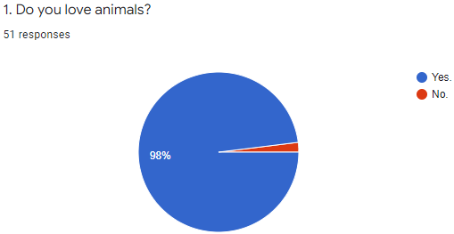
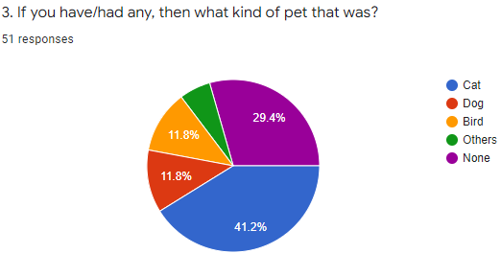


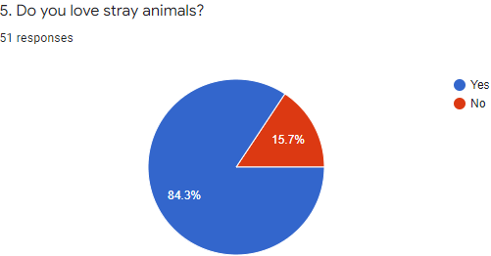
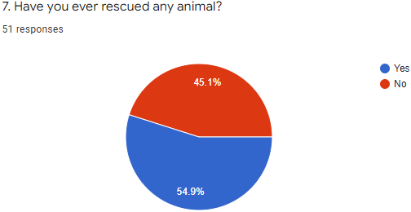
Survey questions with answer.

Slide 19
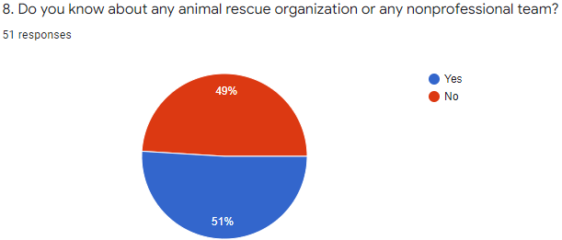
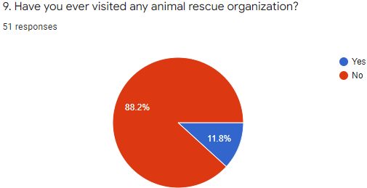
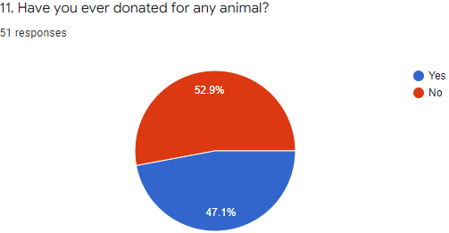
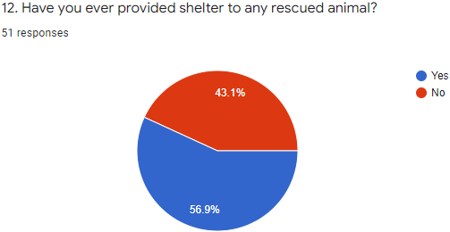
Survey questions with answer.

Slide 20
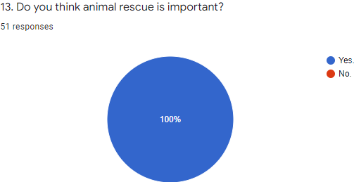
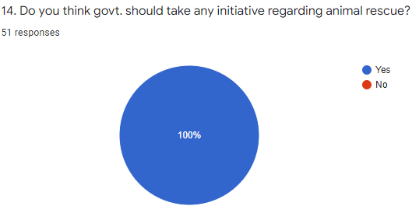
Survey questions with answer.

Slide 21

Survey questions with answer.
Discussion: RQ 1 AND RQ2
RQ 1: How do they get the information and rescue those animals in need?
Ans: As we asked this question to both professional and nonprofessional rescuers, they expressed that mainly social media is the main source of information. Sometimes phone calls also play a vital role but not more than social media. And about the rescue process they mainly handle these type situations on their own as much as possible. But sometimes they need to work as a team to serve the helpless animals.
RQ 2: Where do they treat the wounded animals and give them shelter?
Ans: Both professional and nonprofessional rescuers treat the animals according to their health conditions. If they need general treatment the rescuers work on their own but when they are seriously wounded they take them to vets and experts to help them as much as possible. After the animals recover from their health issues, the rescuers try to return them to their previous home or help them to get adopted or send them to an NGO. But they never leave their sides unless they are sure the animals are safe and healthy.

Slide 22

Conclusion and Recommendation
After briefly discussing the topic “Importance of Animal Rescue in Bangladesh”, We can say that day by day animal rescuers are trying to expand their work and connections all around the country to help as many animals as they can. But without our help it is really hard for them to work on their own. We all should come forward to stand for the helpless animals. We can help them to reach every corner of this country. Even the Govt. can help to make everyone aware of the importance of animal rescue.
We all know that it is not an easy task. But let’s speak for change, let’s make this country a better place for every life.

Slide 23
Appendix
Here are some proofs of our interview:
1. https://drive.google.com/file/d/1mhd9JEAMygLatxPAiP6LYvK9Qocizo0x/view?usp=sharing
2. https://drive.google.com/file/d/1MXRVD1JWx6ZdxSh0SV55V_20pxbAG5Ma/view?usp=sharing

Slide 24
Thank You!

